Slide 1
Warm-core vs. cool-core vortices Combining the prior concepts of: thermal wind and vorticity Background first, then Assignment: slides 22-38
ATM 561, fall 2019
Brian Mapes, Univ of Miami

Slide 2
The big idea of it
In the thermal wind lab, you learned about how the slope of pressure surfaces (indicating the PGF) balances the Coriolis force in geostrophic flow
You also learned how thickness (between pressure surfaces) is proportional to T
This gave you a 3D view of T around wind jets.
But wind always blows in circuits (circulations), so it is often more useful to think of vortices (with vorticity as the budget equation) as the fundament of flow.
Then T is understood in terms of warm and cool cores.

Slide 3
p surfaces on a z-coordinate diagram
for NH westerly jet stream in thermal wind balance
→
z
150 mb
thinner mass (Δp) layers,
cooler compared to
← that
big thickness of mass (Δp)
layers: warm compared to that →
200 mb
300 mb
Jet stream
into page
PGF is “downhill”
Coriolis force to R
500 mb
small thickness of
mass (Δp) layers:
cooler, compared to that→
same mass (Δp) layers
are thicker: warmer than
← that
700 mb
1000 mb
North
South

Slide 4
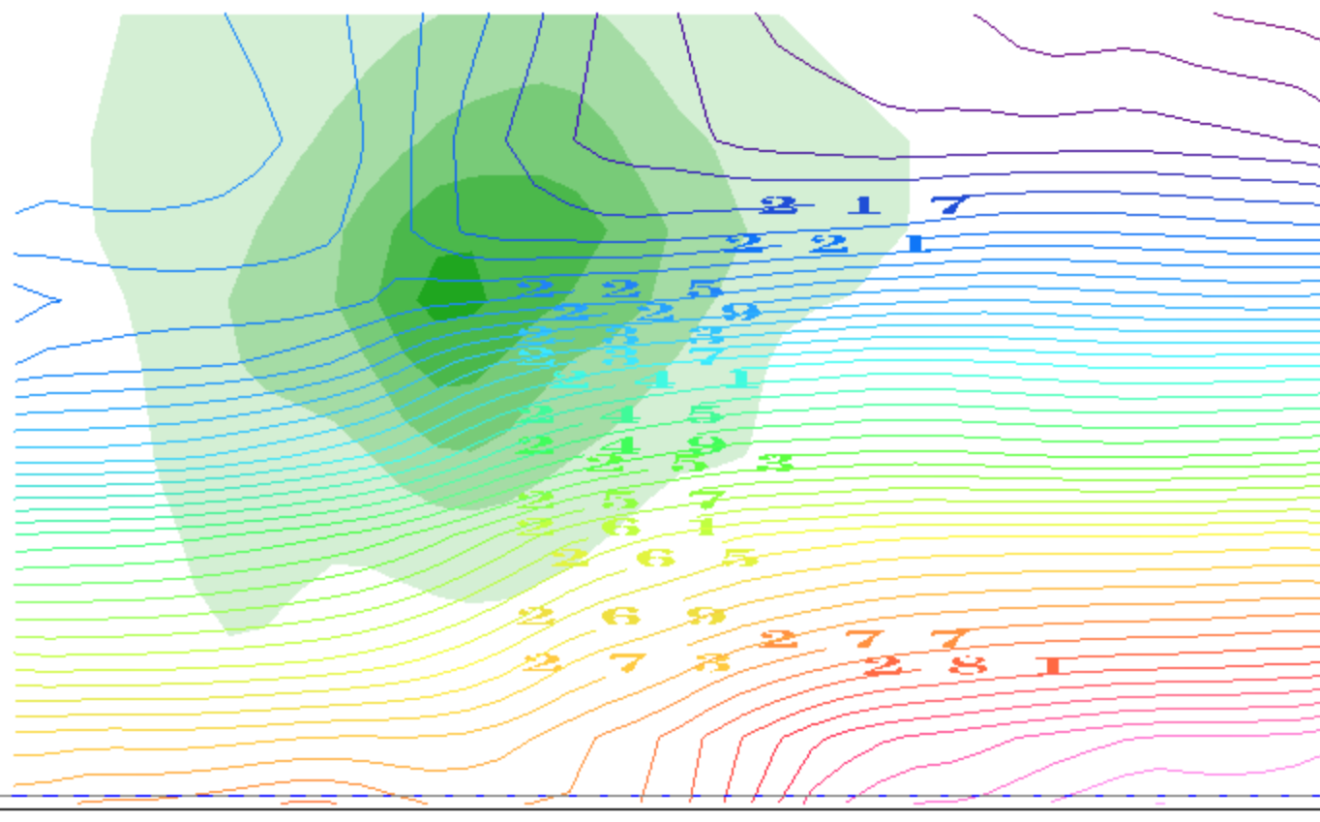
contours of T(K): it decreases with height
(plus the horizontal gradients due to TWB)
thinner mass (Δp) layers,
cooler compared to
← that
big thickness of mass (Δp)
layers: warm compared to that →
small thickness of
mass (Δp) layers:
cooler, compared to that→
same mass (Δp) layers
are thicker: warmer than
← that
North
South

Slide 5
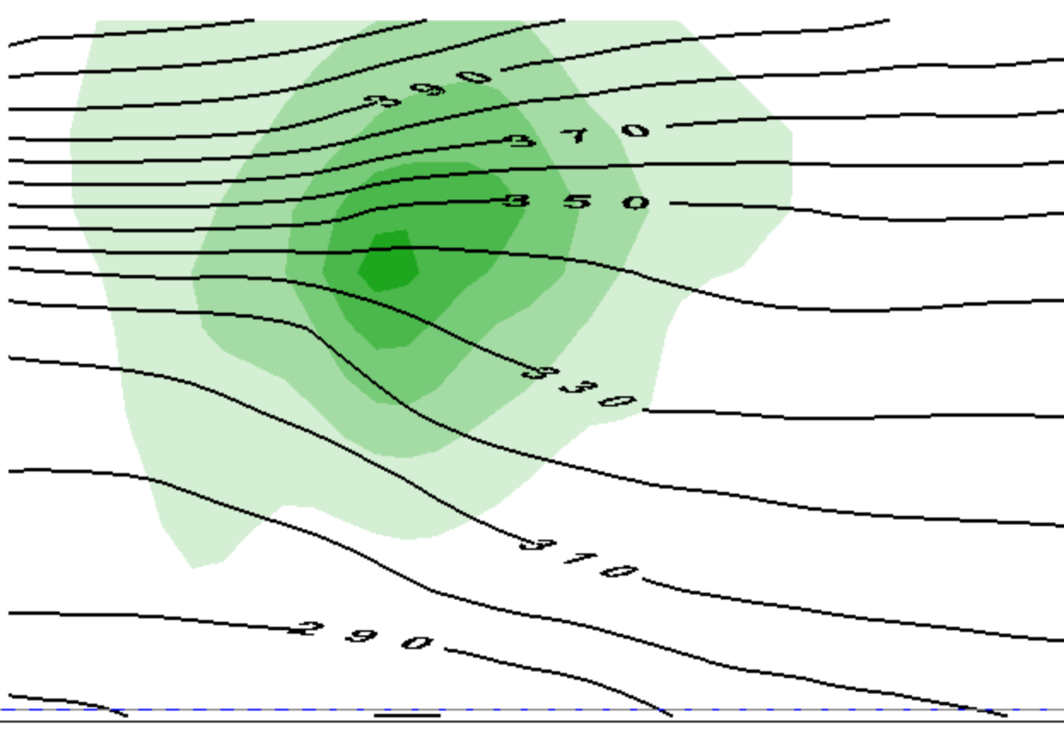
contours of θ(Κ): it increases with height
(plus the horizontal gradients due to TWB)
thinner mass (Δp) layers,
cooler compared to
← that
big thickness of mass (Δp)
layers: warm compared to that →
small thickness of
mass (Δp) layers:
cooler, compared to that→
same mass (Δp) layers
are thicker: warmer than
← that
North
South

Slide 6
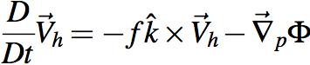
That view emphasized jet streams as the unit of flow
OK, suppose we want to think in those terms.
What is a jet made of?
momentum, or ½ its square KE
per unit mass
What equation governs momentum?

Slide 7
That view emphasized jet streams as the unit of flow
To predict vector momentum V_{h}, need Φ
But that drags thermo into our equation set
must predict T, not just guess its structure by TWB
We work hard to avoid that with vorticity

Slide 8
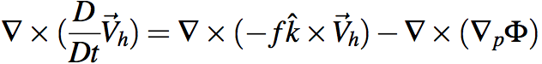
Holy grail of dynamics: get div & ω
Gotta avoid dragging thermo into this via Φ.
Get rid of Φ at any cost. Curl to the rescue!
Ker-CHING!
We are Masters of the Universe with our sexy vector identities!
The grail is in the bag!
Notes:
\nabla \times (\frac{D}{Dt} \vec V_h) = \nabla \times (-f \hat k \times \vec V_h) - \nabla \times (\nabla_p \Phi)

Slide 9
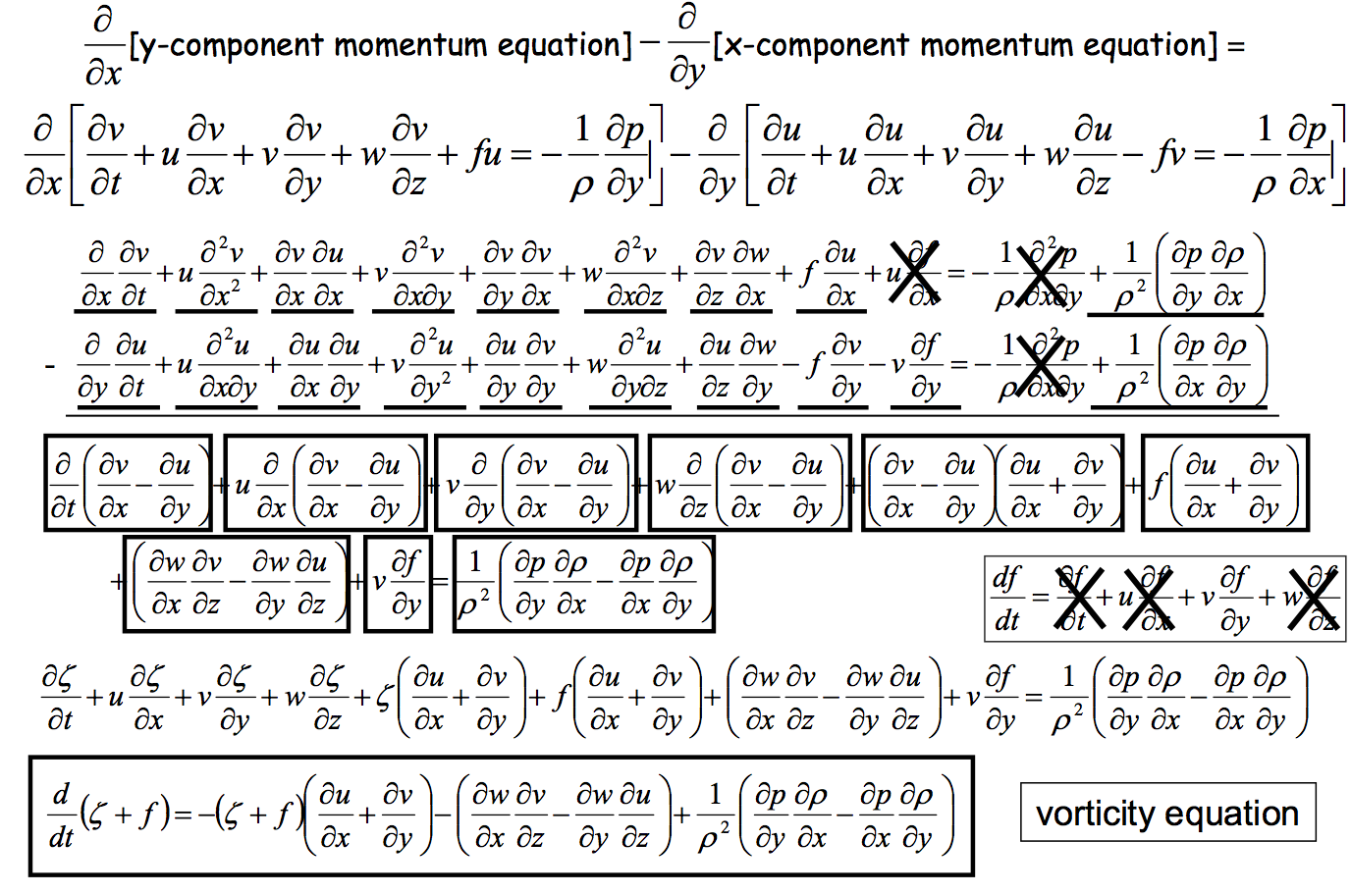
Heh heh ... did I say "any cost"... ? gulp
Can we scrape back some of these cobwebs?
Wait a sec, what's this??

Slide 10
This view emphasizes vortices as the unit of flow
To predict vorticity, we just need vorticity
induced wind drops like 1/distance
vorticity itself is advected by wind like a tracer
plus complications
advection of planetary vorticity f →Rossby waves
divergence term can be rolled up into potential vorticity

Slide 11
So what’s the TWB structure of a vortex?
In this case, one near the tropopause (like the jet stream)

Slide 12
This is only half the story of a vortex
cooler than
← that
warmer than
that →
cooler than
that→
warmer than
← that

Slide 13
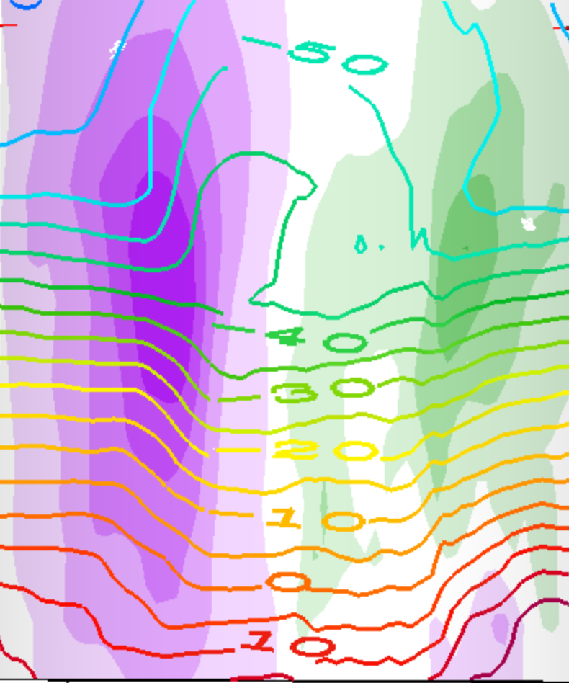
This is a whole vortex (two jets)
T(K) contours
cooler than
that →
warmer than
← that
cooler than
← that
warmer than
that →
warmer than
that →
cooler than
← that
cooler than
that→
warmer than
← that

Slide 14
This is a whole vortex (two jets)
T(K) contours
warmer than
← that →
above the core
cooler than
← that →
below the core

Slide 15
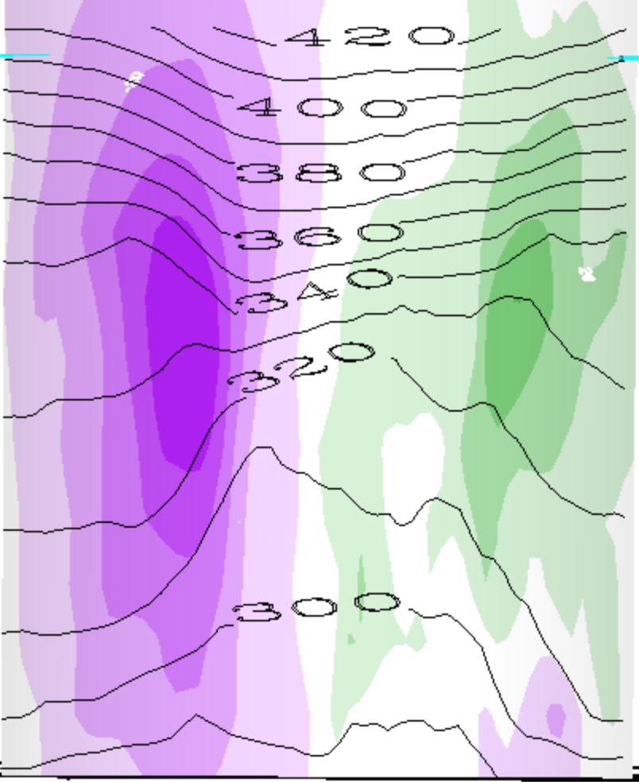
This is a whole vortex (two jets)
θ(K) contours
warmer than
← that →
above the cyclone
cooler than
← that →
below the cyclone

Slide 16
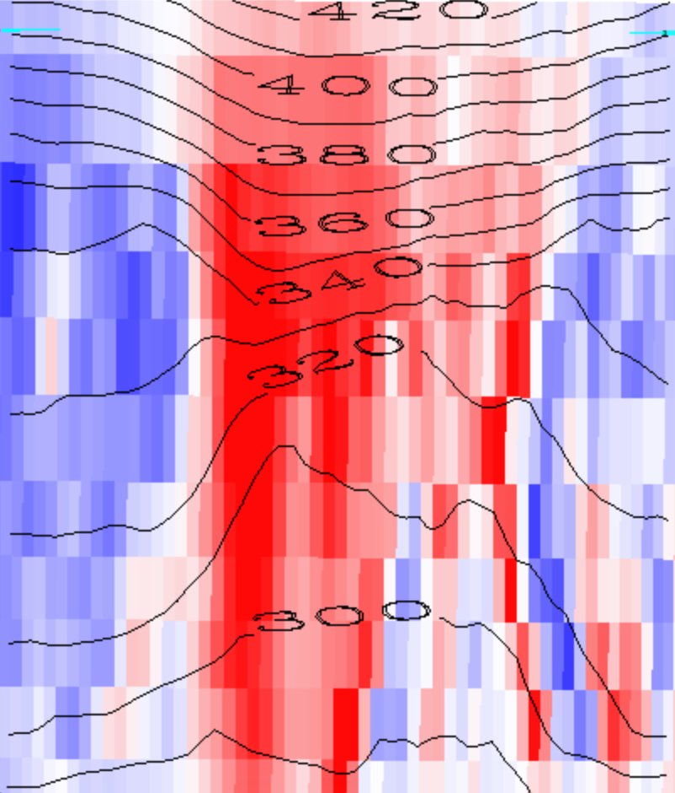
Red is positive vorticity , θ(K) contours
warmer than
← that →
above the cyclone
cooler than
← that →
below the cyclone

Slide 17
Red is positive vorticity , θ(K) contours
warmer than
← that →
above the cyclone
Cyclonic Vortex
cooler than
← that →
below the cyclone

Slide 18
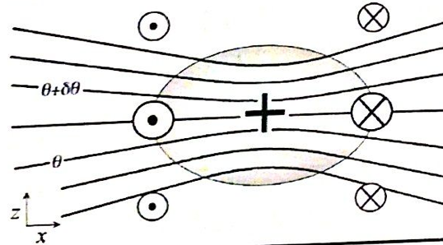
Generalization: PV
1. We will see that every cyclonic vortex obeying vertical (hydrostatic) and horizontal (geostrophic or other) balance looks similar to this (maybe stretched or shrunk):
PV > 0

Slide 19
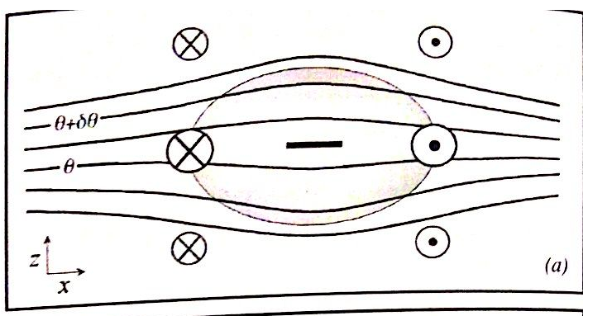
Balanced anticyclones exist too...
Just the opposite of a cyclone...
PV < 0

Slide 20
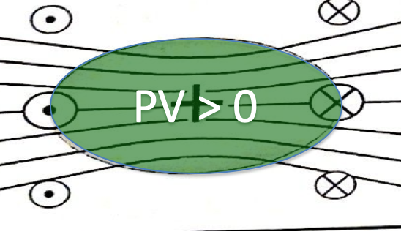
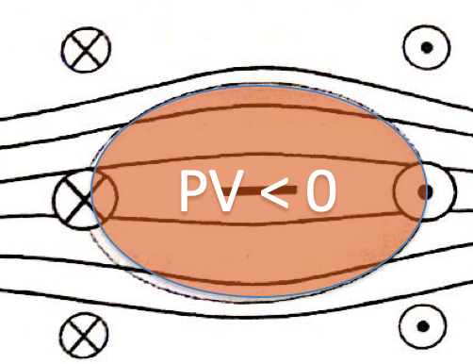
Vorticity (or PV) blobs
Where do they come from?
How do they interact?
(this we studied, in the horizontal plane)
Do they get destroyed?
(Soon: tackling the complications)

Slide 21
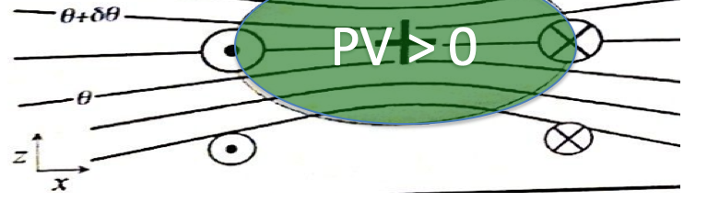
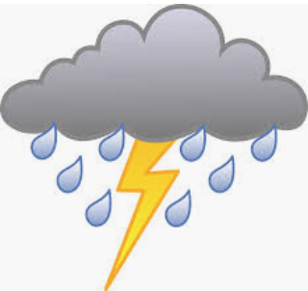

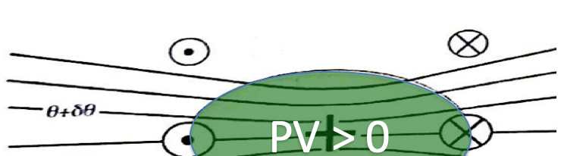
Since our main weather concern is in the lower troposphere (where water is),
This is called a cool core cyclone:
This is called a warm core cyclone:

Slide 22
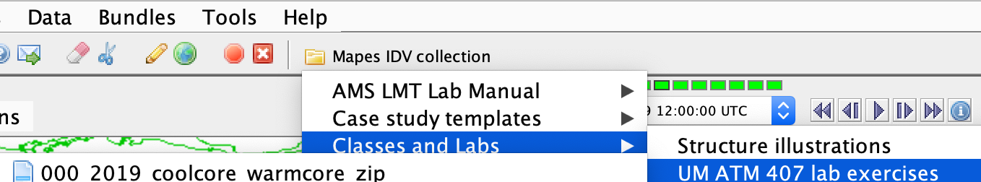
IDV lab assignment -- part 1
Open Mapes IDV → UM ATM407…
0000_coolcore_warmcore…
Explore ALL of its displays, at ALL of its times (loop the animation). Learn to use the IDV. The Help menu has pan-zoom help on top. A mouse is a HUGE help for 3D views.

Slide 23
IDV lab assignment -- part 1
In the following slides, make and label and explain nice clear illustrations like slides 13-17, but for
a warm core anticyclone
a warm core cyclone
a cool core anticyclone

Slide 24
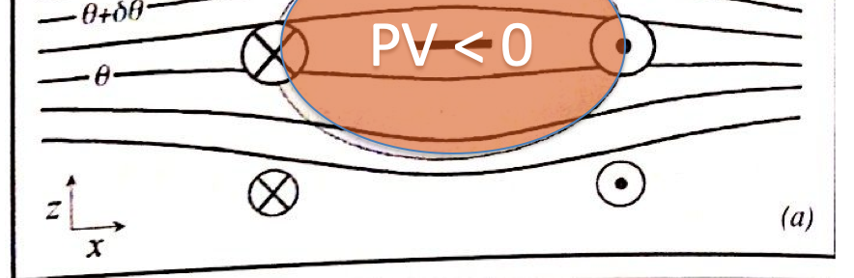
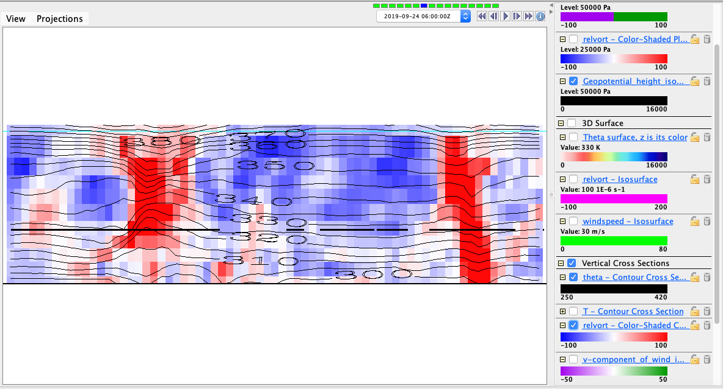
A warm core anticyclone
This shows a warm core anticyclone, evident by the vorticity aloft, along with the dips in the theta surfaces near the surface, but divergence of surfaces in the central layer. This is over southern California. Further aloft, there appears to be a possible upper level cyclone, but the focus here remains within the boxed region.

Slide 25
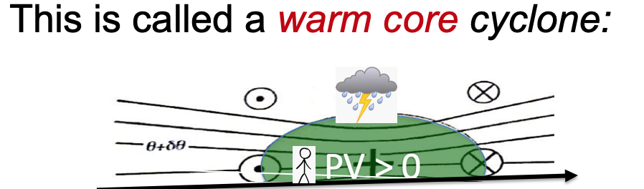
A warm core cyclone
This shows a warm core cyclone, evident by the near surface vorticity, along with the dips in the theta surfaces, especially near the surface. This is from the tropical storm in the Atlantic Basin

Slide 26
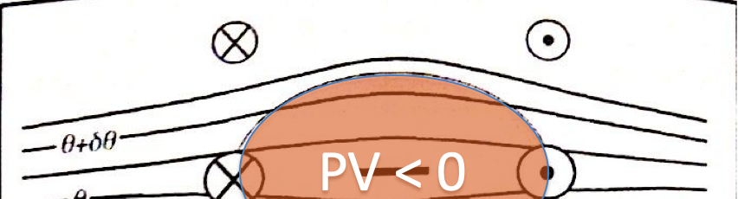
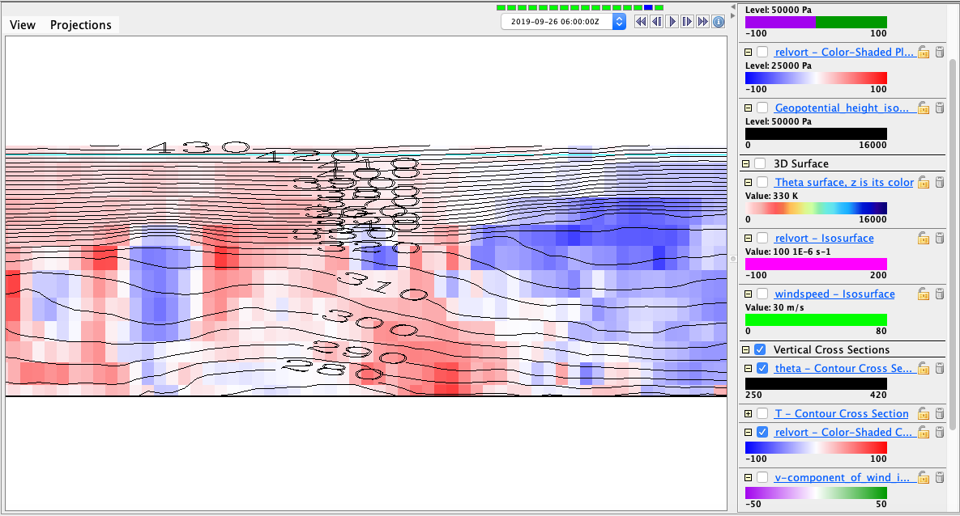
A cool core anticyclone
This shows a cool core anticyclone, evident by the near surface vorticity (albeit weak), along with the humps in the theta surfaces, especially near the surface. This is in Northern Canada.

Slide 27
Isentropic surfaces
Isentrope contours on the cross sections above are slices of isentropic surfaces
surfaces of constant entropy
or potential temperature, or dry static energy C_{p}T + gz
Let’s learn to see isentropic surfaces
They are almost like material surfaces
because Dθ/Dt = 0 for adiabatic flow
(plus nonadiabatic or “diabatic” complications)
Their vertical motion is air vertical motion!
the holy grail, for clouds+rain (weather)

Slide 28
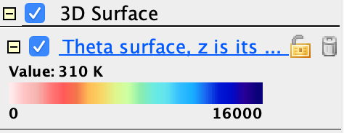

IDV Lab assignment part 2
In the same bundle, activate (check) the display called “Theta surface, z is its color”
Adjust the value (310K, 330K, 360K)
Use vorticity isosurfaces and cross sections in an illustrated description of its topography.
Is there a mean north-south slope? hint:
What vorticity features (Part I) explain dimples?
What vorticity features (Part I) explain peaks?

Slide 29
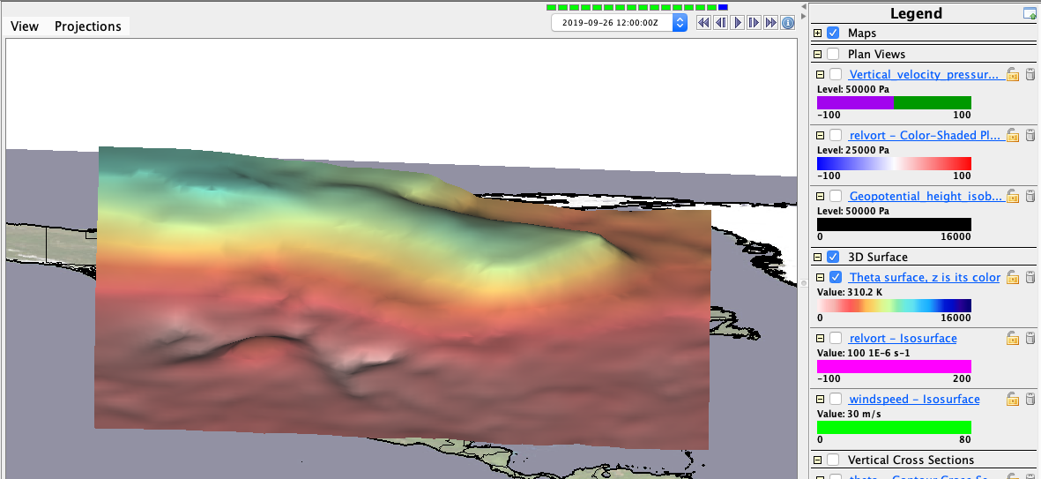
Mean slope of the 310K isosurface
In general, we see a positive increase in the height of the isosurface as we move northward.

Slide 30
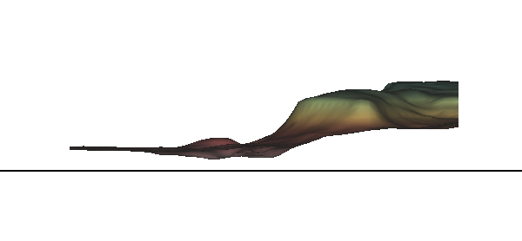
Mean slope of the 310K isosurface
This shows the same thing as in the previous slide, but as a side view for reference on steepness of the slope

Slide 31
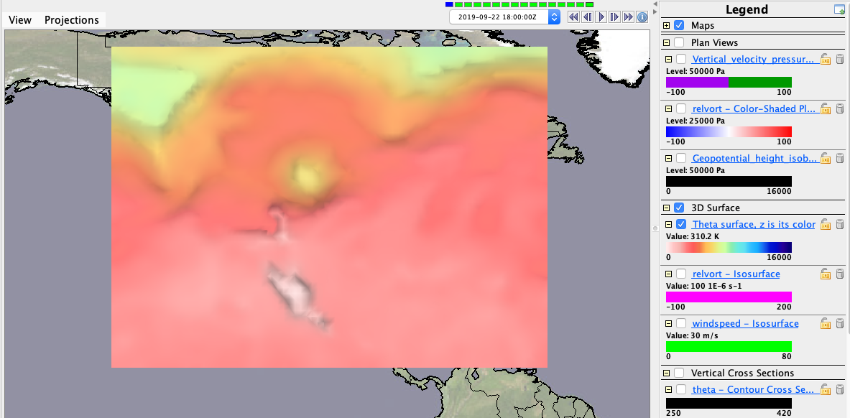
A depression in the 310K surface Where? Describe the situation
There is a depression in the 310K surface where the box is.

Slide 32
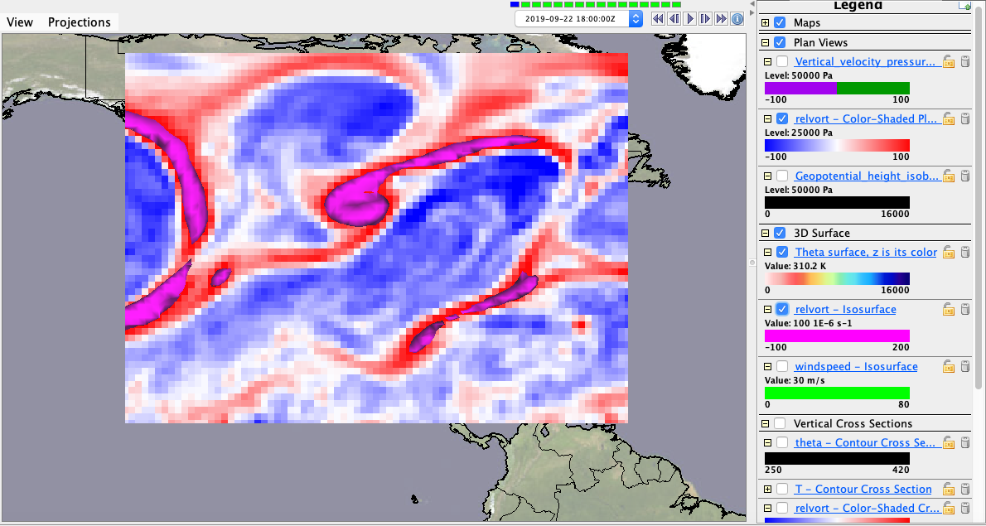
A depression in the 310K surface Where? Describe the situation
Where there is the depression, there is no vorticity, yet there is some created by the areas around it. This could be because the depression is also not well pronounced.

Slide 33
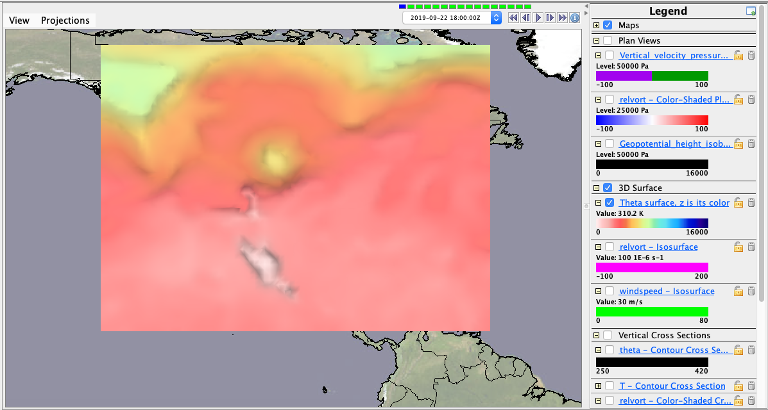
A peak in the 310K surface Where? Describe the situation
There is a peak in the 310K surface where the box is.

Slide 34
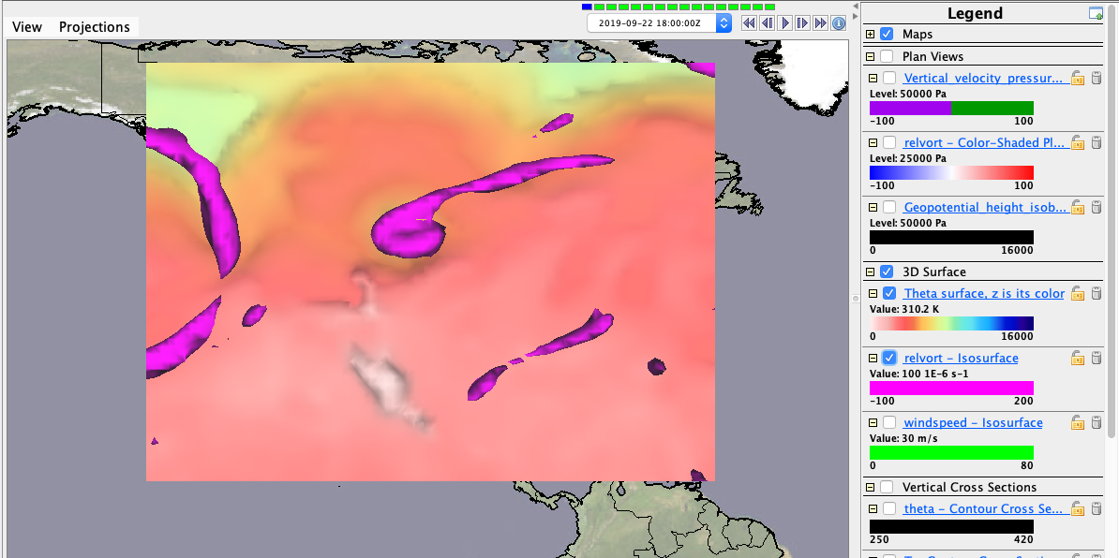
A peak in the 310K surface Where? Describe the situation
Where this peak is, there is a large amount of vorticity, signaling some type of cyclonic activity.

Slide 35
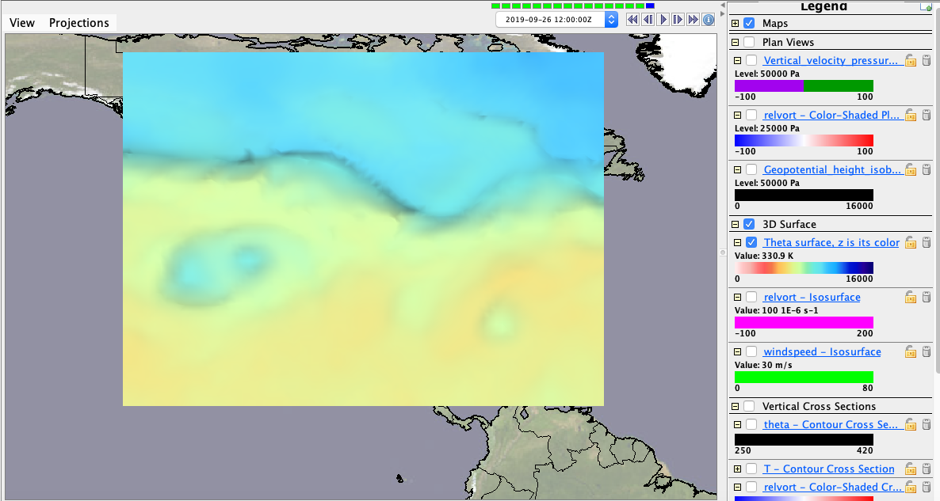
Mean slope of the 330K isosurface
In general, we see a positive increase in the height of the isosurface as we move northward.

Slide 36
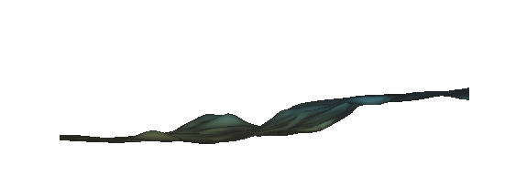
Mean slope of the 330K isosurface
This shows the same thing as in the previous slide, but as a side view for reference on steepness of the slope. It is less steep than the 310 isosurface.

Slide 37
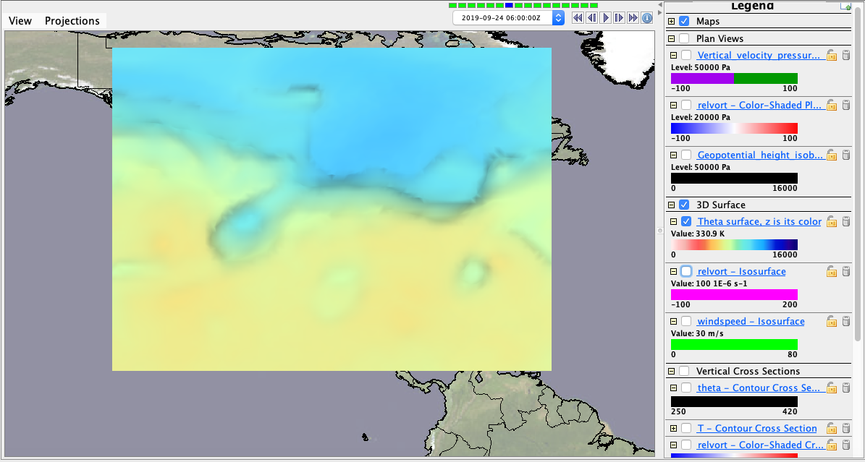
A depression in the 330K surface
This shows a depression in the box in the isosurface.

Slide 38
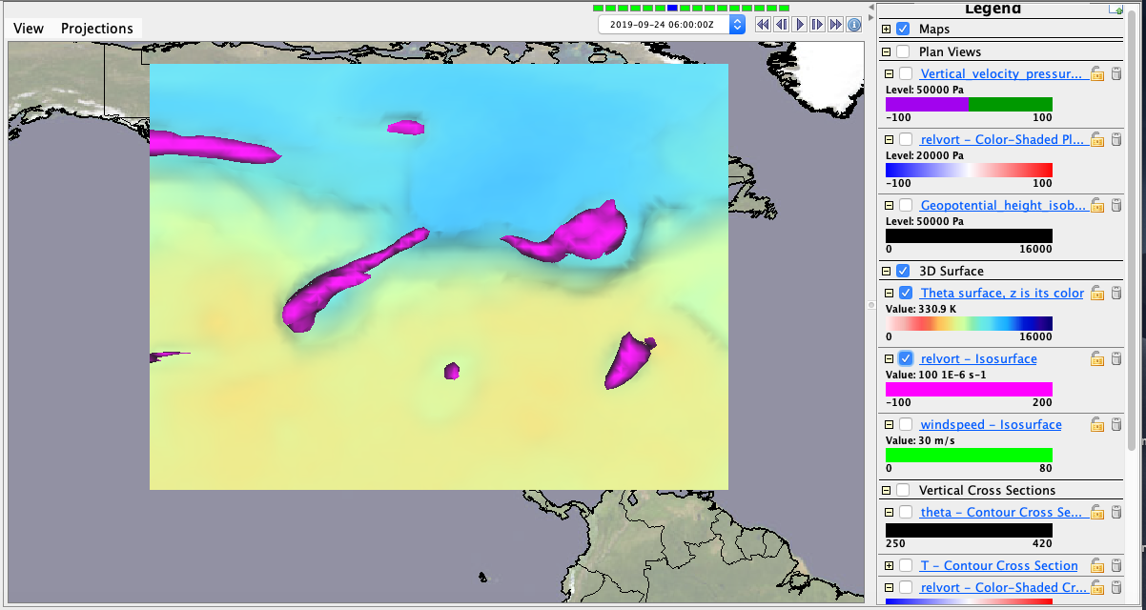
A depression in the 330K surface
This shows the same depression, but now shows vorticity overlaid, which indicated cyclonic activity.

Slide 39
A peak on the 330K isosurface
This shows a peakin the box in the isosurface.

Slide 40
A peak on the 330K isosurface
This shows the same peak, but now shows vorticity overlaid, which indicated cyclonic activity.

Slide 41
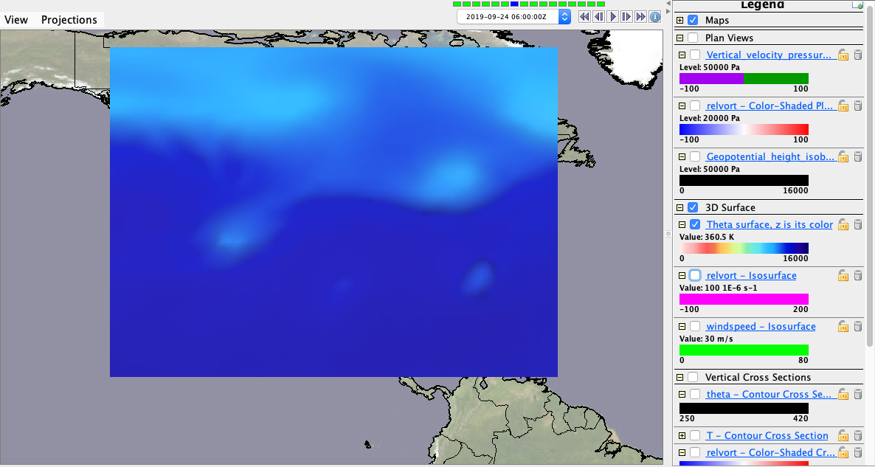
Mean slope of the 360K isosurface
In general, we see a decrease in the height of the isosurface as we move northward.

Slide 42
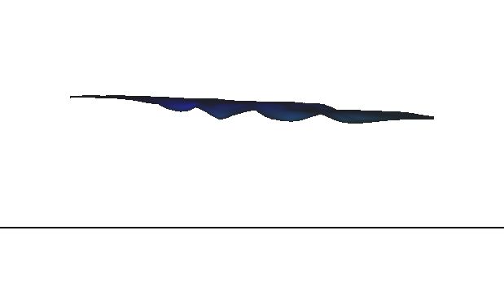
Mean slope of the 360K isosurface
This shows the same thing as in the previous slide, but as a side view for reference on steepness of the slope. There is a minimal slope and definitely more “smooth” than previous surfaces.

Slide 43
A depression in the 360K surface
This shows a depression in the box in the isosurface.

Slide 44
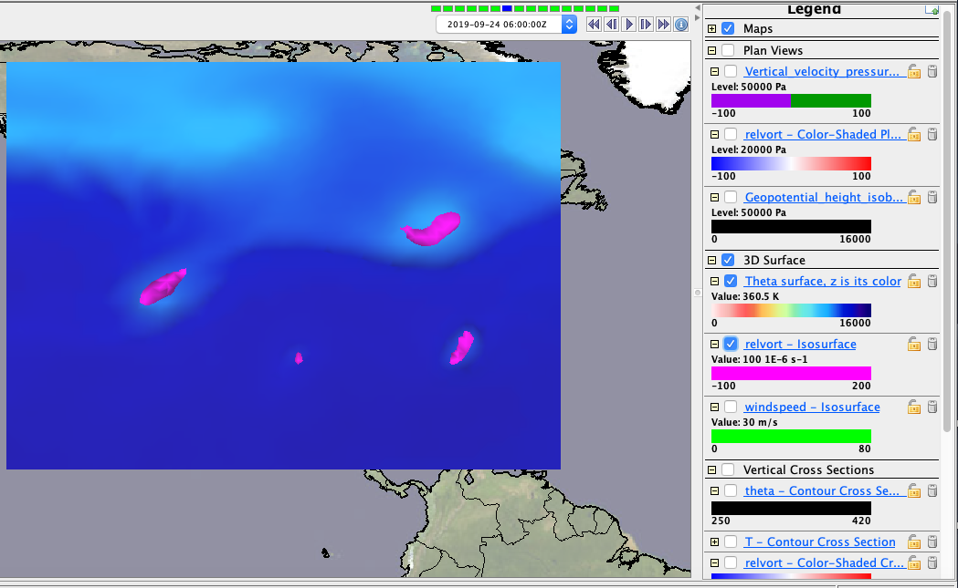
A depression in the 360K surface
This shows the same depression, but now shows vorticity overlaid, which indicated cyclonic activity.

Slide 45
A peak on the 360K isosurface
There were no peaks evident in the data given for the 360K surface.

Slide 46
Use the Print facility of Powerpoint
to put a PDF of this into your class Github repository
so we can look them over in class

